Slide 1
CALP Tips:
Where to find the right forms
Tips on how the forms should be filled in
What else you may need

Slide 2
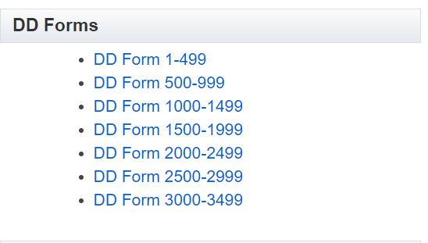
Use the most current forms. The site for official DOD forms is:
https://www.esd.whs.mil/directives/forms/
Choose this batch of forms
$$←$$

Slide 3
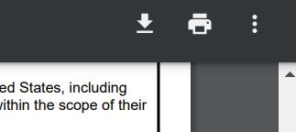
Click on the form you need. (Don’t worry that it says Air Force, that only means that they own the forms.)
Once the form opens,
you can fill it in and then download and/or
print it.

Slide 4
Here are some tips that apply to all
of the documents

Slide 5
Legible
Dated
Signed
Current
All forms must be legible, dated and signed. Blurry forms, undated forms or unsigned forms must be corrected and resubmitted.

Slide 6
All forms should reflect the exact same legal name. No nicknames or partial names please.

Slide 7
The signatures on the 2400/01/02
Should be blue ink
We do accept electronic copies, but signatures are still required to be blue ink.

Slide 8
Corrections to the application should be made by the applicant!
These forms are the basis of a legal agreement that is being made with the government. Any changes that are needed for the CALP application must be made by the applicant.

Slide 10
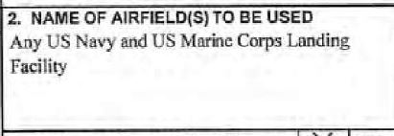
The NAVY only approves NAVY CALP requests. All other references must be removed.
You may only use the facilities where you have valid official business, no extra facilities will be approved.
Also, the “use” information should go in block 4. purpose of use, not in block 2.

Slide 11
COR name and contact information
Avoid accidently adding “extra” or “just-in-case” uses.
Excess verbiage may not appear in block 4. In this example “j… and o....” must be removed. “Other” or “additional” uses are not approved.
Feel free to clarify approved uses with the Contracting Officer’s Representative (COR).

Slide 12
Don’t leave any blanks. If the answer is “0” then “0” should be entered in the block.

Slide 14
Only the insurance company should fill out the 2400. Corrections can only be made by the insurance company.

Slide 15
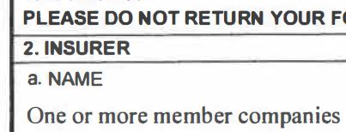
If the insurance company indicates
more than one provider, there must be a
providers list included with the submission.

Slide 16
ONLY ONE of these blocks should be used.
Block 5
Block 6: Single limit liability
If block 5 is used…
Block 1a and 1c should be filled in as well as Blocks 2a, b and c.
The liability limits will be separate in this block.
Seems easy, but is often incomplete.
This is for single limit use only.
The dollar amount in this block should show at least the minimum combined coverages.
Passenger amount can be sub-limited to a minimum of 100k per passenger but it must come from the combined total.

Slide 17
Privately owned general aviation flights weighing less than 12,500 lbs.

Slide 18
Cargo flights and aircraft being flight-tested ferrying no passengers are required to carry a minimum insurance amount of 1 million for bodily injury (minimum of 100,000 per person, so the amount can be larger if required) and a minimum of 1 million for property damage.
Privately owned commercially-operated aircraft used for passenger carrying and privately owned non-commercially-operated aircraft of 12,500 pounds or more certified maximum gross takeoff weight will be insured for: the minimum insurance amount of 1 million for bodily injury (minimum of 100,000 per person, so the amount can be larger if required) and a minimum of 1 million for property damage plus passenger liability of at least 100,000 per person (based on passenger seats). * A discount may apply. The next slide explains the discount.
Privately owned non-commercially-operated aircraft of less than 12,500 pounds will be insured for: the minimum insurance amount of 500,000 for bodily injury (minimum of 100,000 per person, so the amount can be larger if required) and a minimum of 500,000 for property damage plus passenger liability of at least 100,000 per person (based on passenger seats).

Slide 19
DD 2402
Hold
Harmless
Agreement

Slide 20
The two required signatures must be made by people who are legally authorized to bind the company to indemnification with the US Government.
Sometimes, that power is inherent, as with Corporate Officers: President, Vice President, Treasurer,
Corporate Secretary, Chief Executive Officer, Chief Financial
Officer or Chief Operations Officer.

Slide 21
At times we may need more information.
It may not be obvious as to how the company, partnership or
LLC is set up as far as it relates to legal signatories.
There are many different titles: “Head” or “Director,” Partner,
Managing Member, Member Manager or just Member.
In those cases you will need filed and numbered Corporate
documents, or LLC Member agreements, Partnership
agreements, notarized affidavits, etc. Don’t worry, we will ask
If we need something extra.

Slide 22
Last but not least
We will need either your COR letter, your contract, an official memo, your written orders, your official invitation and/or a statement of good standing from the flying club president, if you’re a member.
If you don’t know which of these you’ll need, don’t worry, we will ask. Please be prepared to identify your government point of contact and their phone number or email address.

Slide 23
If you still have questions please reach
out to the local Airfield Manager or to
CALP Headquarters @
CALP.HQ@navy.mil
Photos courtesy of Gold Dust Photography

